Slide 1
Commission on Aging
Annual Report
FY 2022-23

Slide 2

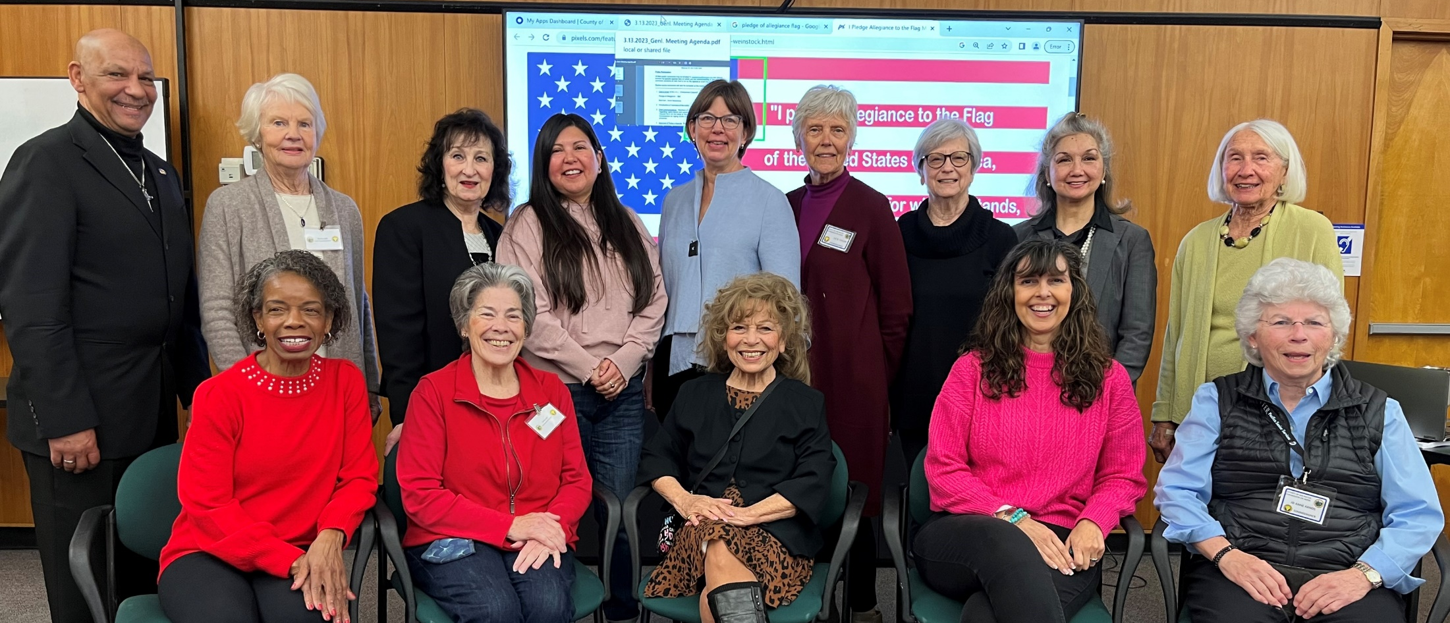
Commission on Aging
MAINTAIN – ENHANCE – IMPROVE THE QUALITY OF LIFE
FOR OLDER ADULTS IN SAN MATEO COUNTY

Slide 3
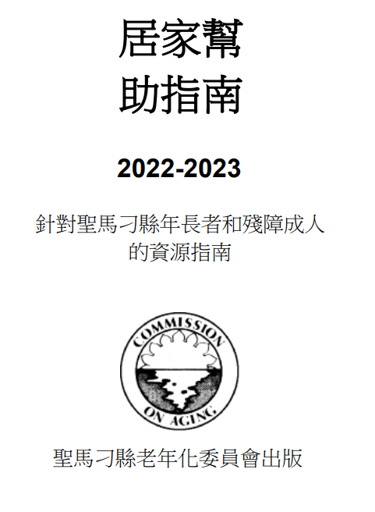
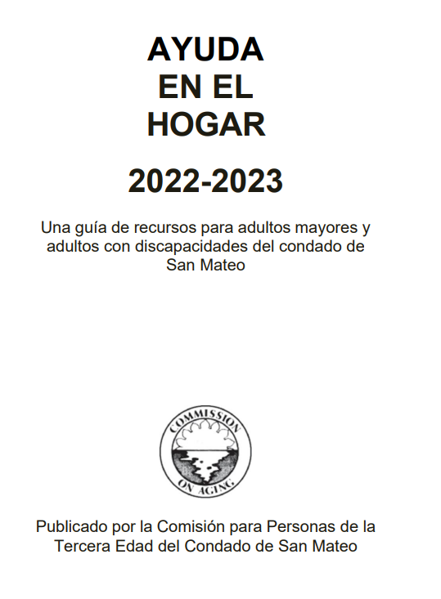
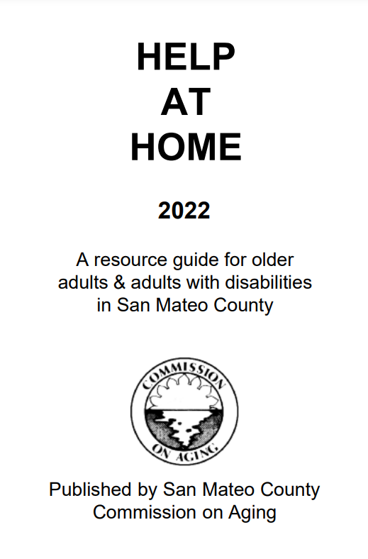
Accomplishments - Increasing awareness of critical resources
Community Need: How to access services / benefits?
Help at Home Guide
Active cooperation between Commission on Aging and cities in San Mateo County
About 4,000 copies are distributed

Slide 4
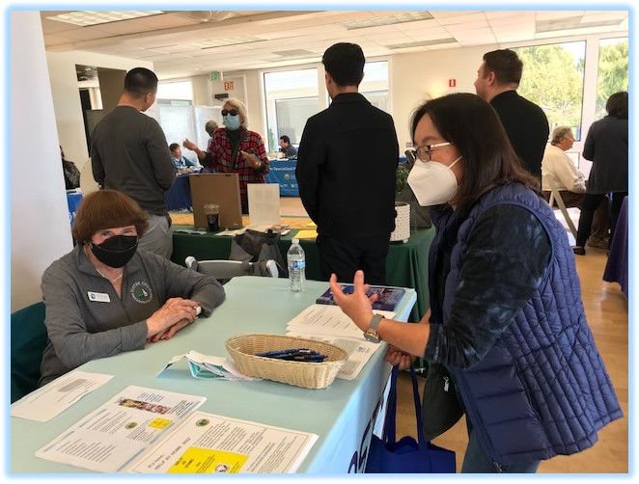
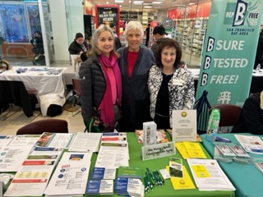
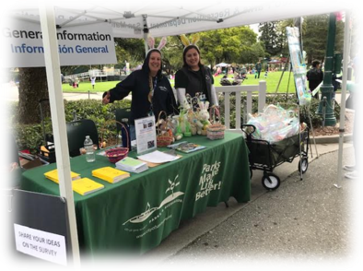
Accomplishments - Increasing awareness of critical resources
Community Need: How to access services / benefits?

Slide 5
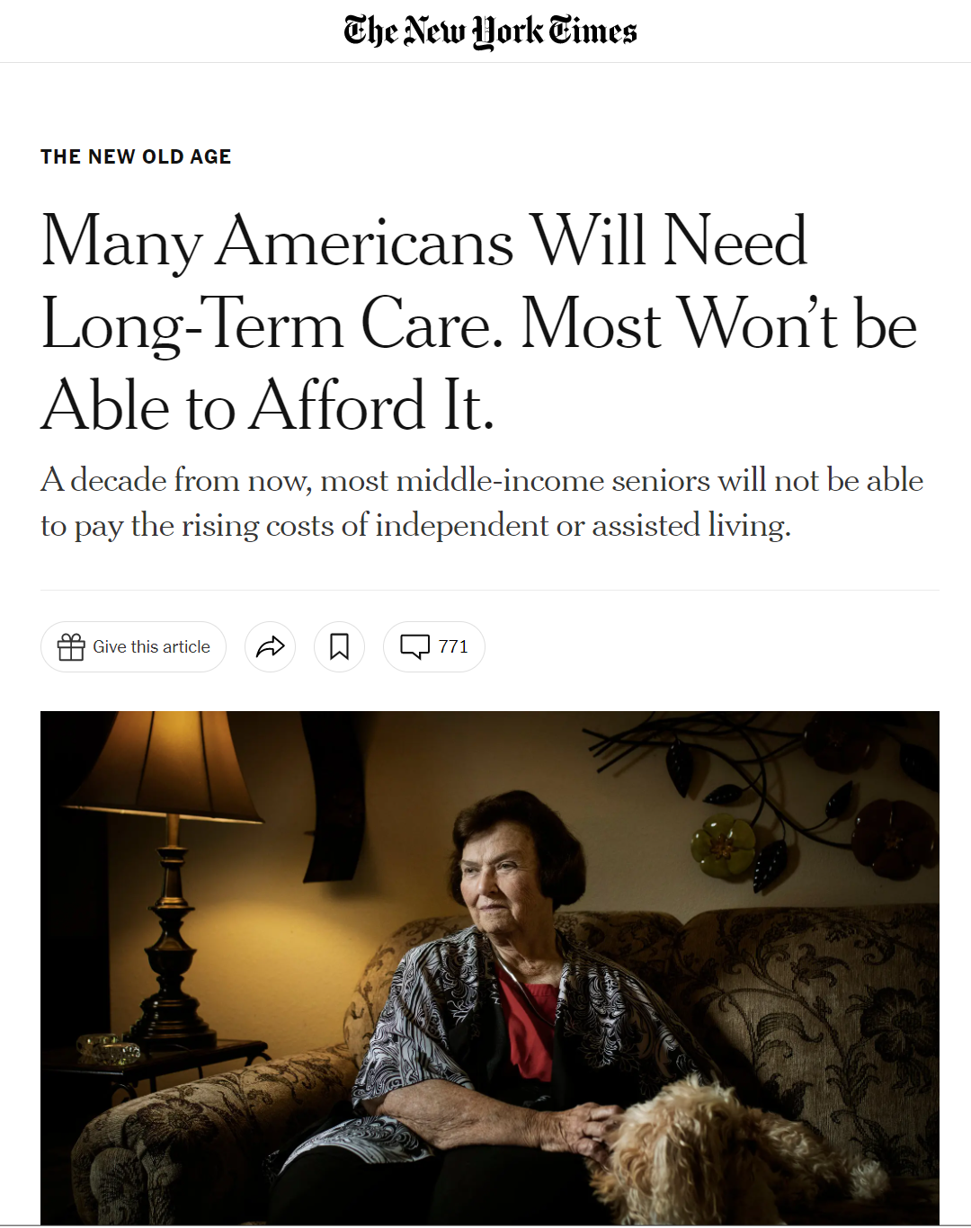
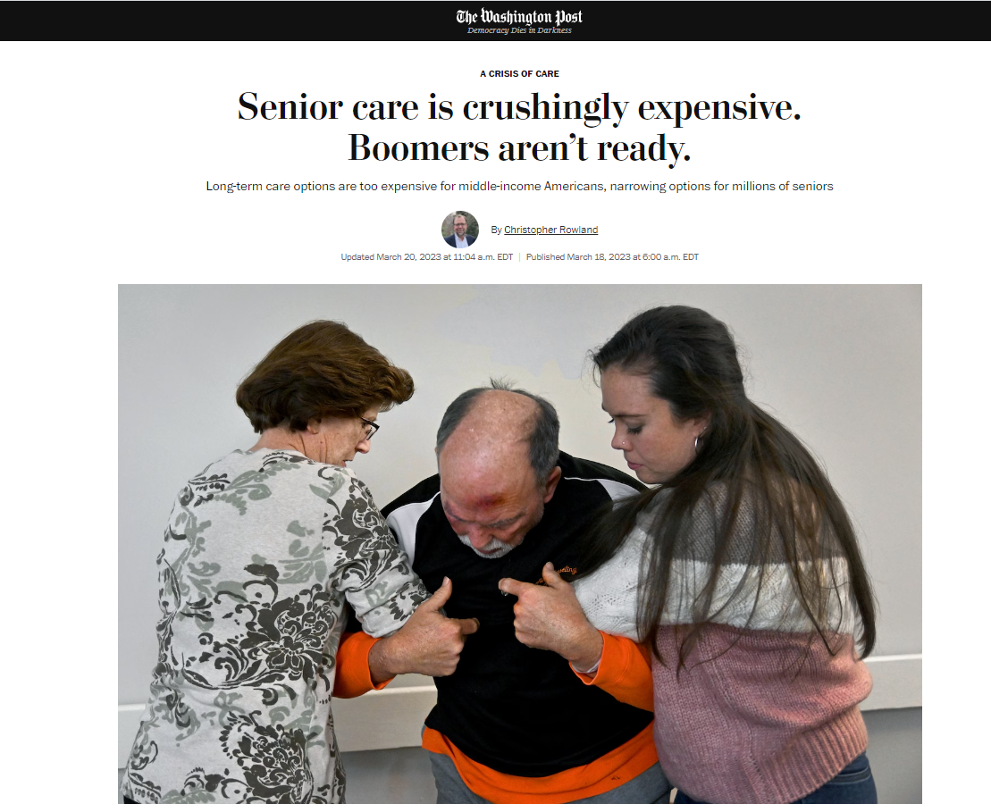
Accomplishments - Advocacy Agenda: Long Term Care
Community Need: Long Term Care
Long-term costs represent “the single largest financial risk” facing older adults.
(National Council on Aging and UMass Boston, 2020 report).
https://www.washingtonpost.com/business/2023/03/18/senior-care-costs-too-high/
https://www.nytimes.com/2019/05/10/health/assisted-living-costs-elderly.html

Slide 6
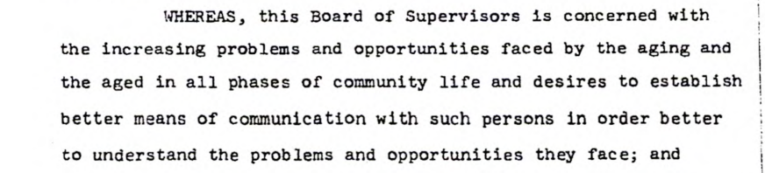
Charter

Slide 7



Commission on Aging Committees
Resource Access and Inclusion
Transportation and Aging in Community
Middle Income Senior Opportunities

Slide 8
Commission on Aging
Thank you for your support of
older adults in our community!

